Slide 1

PMOD: LED & SWITCHES
By David Chun
5/11/2022
Notes:
Hello everyone, my name is David Chun. Today I am presenting on the topic of Pmod: LED & PMOD SWITCH

Slide 2


Introduction
What is a PMOD?
SSD
LED
SWITCHES
My Design
Project Outline
Code
Simulation
Troubleshooting / Difficulties
Notes:
To begin, I will start off with PMODs, its purpose, what it works with, and some common examples. My final topic will be about what I did for this project. Lets get started.

Slide 3
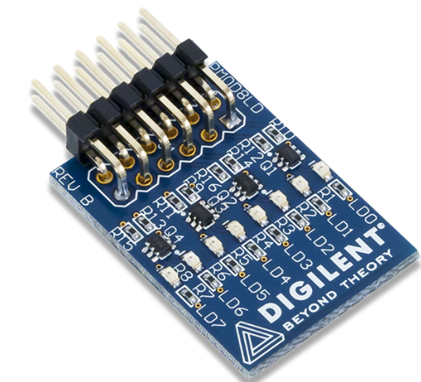
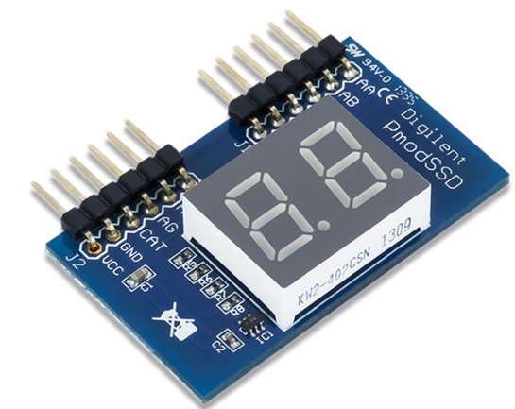
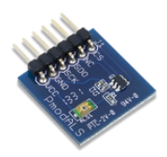
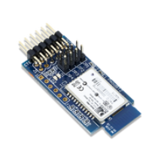
PMOD
Created by Digilent
Compact I/O interface board
Used with FPGA and microcontroller development boards
User Friendly
Common Pmods:
LEDs
SSDs
Ambient Light Sensor
Bluetooth Interface
Notes:
A Pmod is a brand of devices created by Digilent. It is a small I/O interface board that extends the capabilities of programmable logic and embedded control, or FPGA/microcontroller boards. Pmods allow for sensitive signal conditioned circuits and high-power drive circuits to work efficiently when placed at an optimal location. They offer a variety of different Pmods such as Sensors, Wireless Communication Modules, microSD Card Slots, Audio, etc. They are made to help users create their designs with affordability and ease. I used a 2 digit seven segment display pmod, an eight led pmod, and a 4 switch pmod for my project.

Slide 4
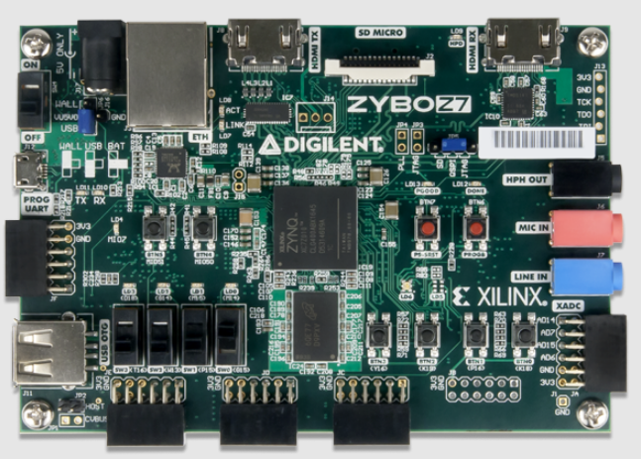
My Design
Test Plan
Create inputs/outputs
Create a case from 00 to 15
Map pinouts of Pmod
Record results
Zybo Z7 10 FPGA Board
Notes:
At the start of my project, I planned on initially creating a digit counter to display on the 2 digit seven segment display. However I was unable to fix my code and display the correct output for my design. So I then decided to create a bit adder that is shown through the pmod leds alongside pmod switches. I was able to scrap some of my failed 0 to 99 counter code and use it to make a small bit adder. To do so, I followed a 4 step test plan as seen on the screen. I first made my inputs and outputs: a clock, a register for the switches, a register for the segments of the display, and a register for the digit select. I then created a counter that had 15 cases. For cases 10 – 15, they were displayed in hex. Third, I then I mapped the pins of the Pmods to the Zybo Z7 10 FPGA board. I then ran synthesis and implementation. And finally I created a bitstream to test the Pmods.

Slide 5
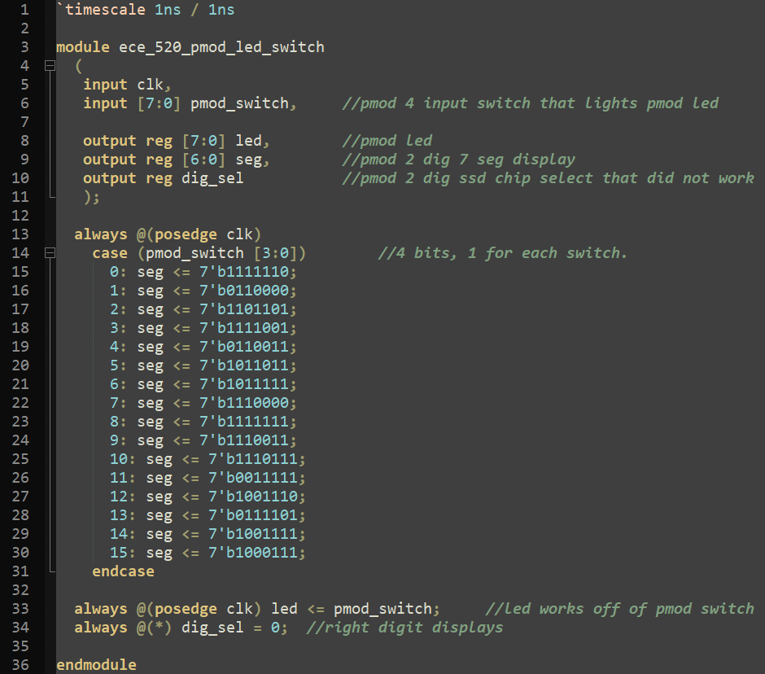
My Code

Slide 6
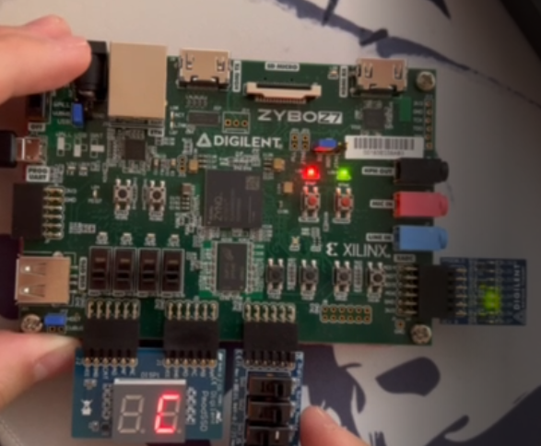
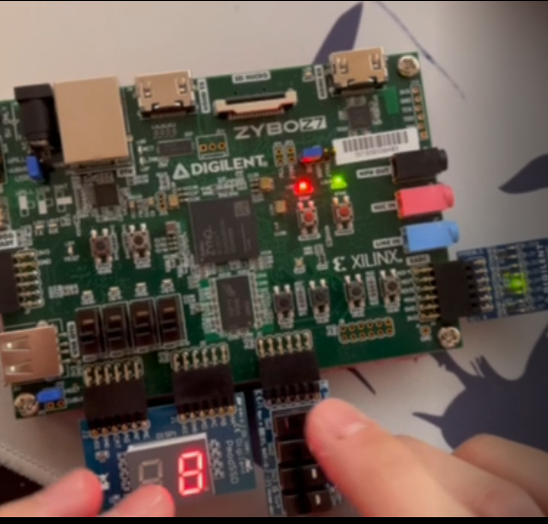

Slide 7
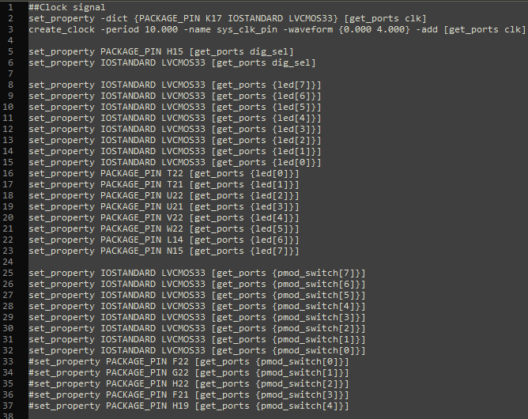
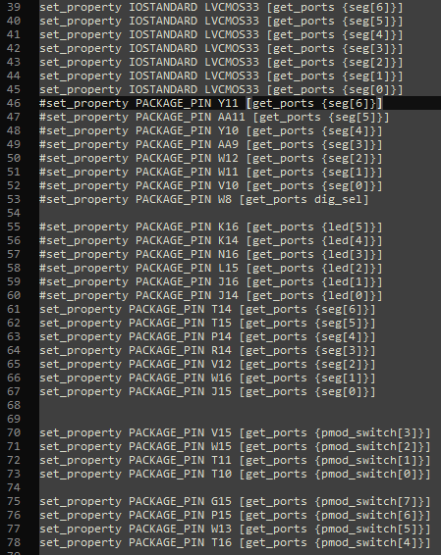
Notes:
Here are my constraints used.

Slide 8
DEMO

Slide 9
Extra Slides

Slide 10
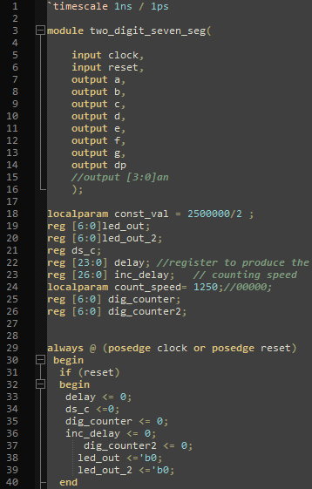
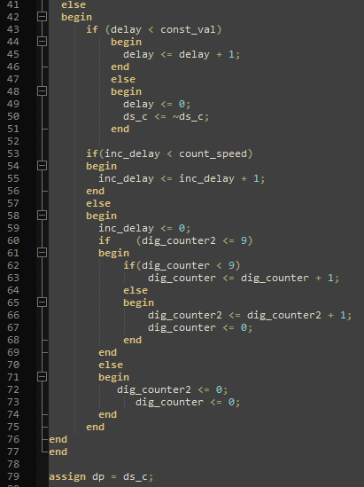
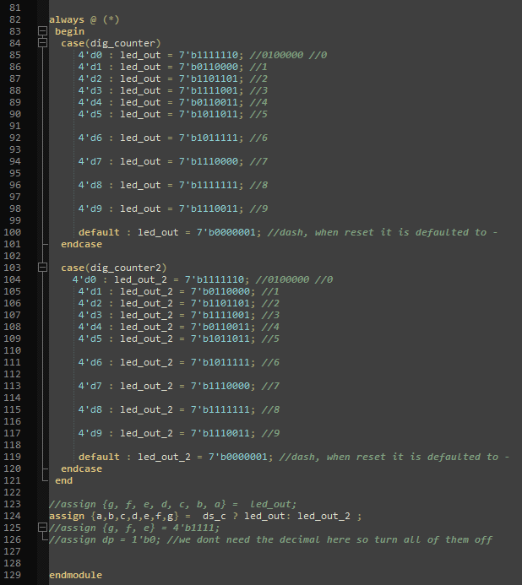
Counter 0 to 99 code
Notes:
Here is the code for my design. I created a module with 2 inputs and 8 outputs. I used 7 bit size for my registers since 99 in binary is 7 bits long (1100011) I calculated the value of my clock using the data sheet given my Xilinx for the Zybo Z7 10 board which is at 125 mega Hertz clock speed. And a chip select delay of 2.5Mega Hz. I mapped the LED segments at the end, where 1 is a high ‘on’ and 0 is a low ‘off’. The seven segments of the Pmod were titled a through g. They would light up in a User controlled orientation as seen in my case statement. The dp/ ds_c would decide which digit is currently receiving the signal to turn on.

Slide 11
Simulations
Notes:
Here are my simulations. Dig_counter_2 is my 1st digit and my dig_counter is my 2nd digit. As you can see, when the first digit is 0, it holds 0 until the second digit goes from 0 to 9. This continues to increment until the first digit hits 9. When both the first digit and second digit are 9, the pmod displays a value of “99”, it resets back to 00 thus achieving a 2 digit counter. I was able to successfully obtain a correct simulation and proved that my code functioned.

Slide 12
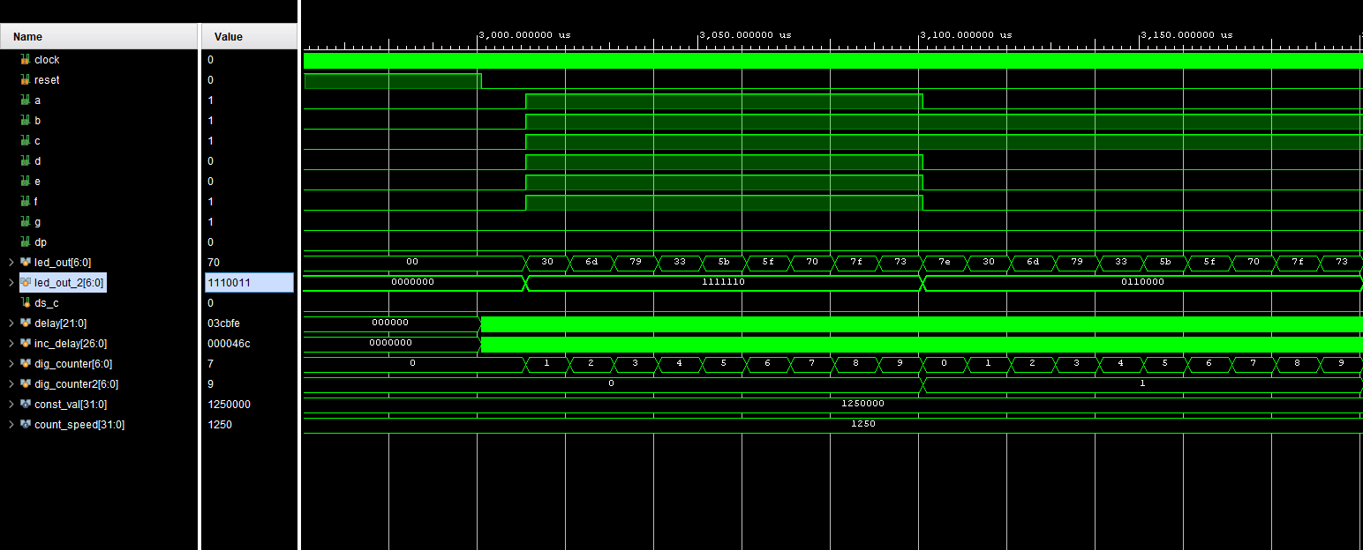
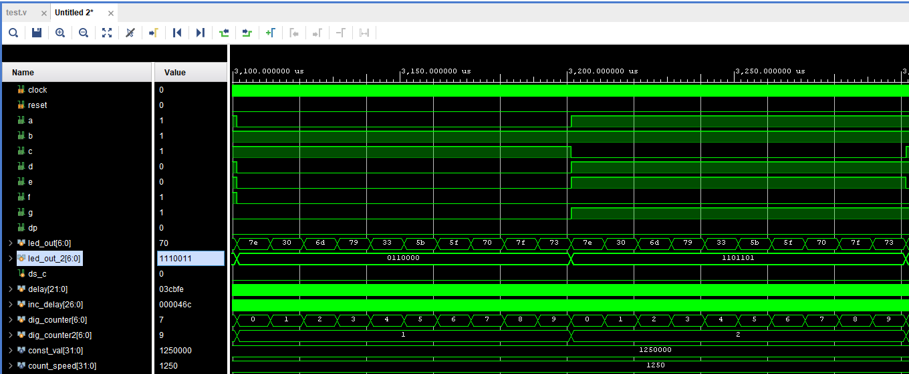

Slide 13
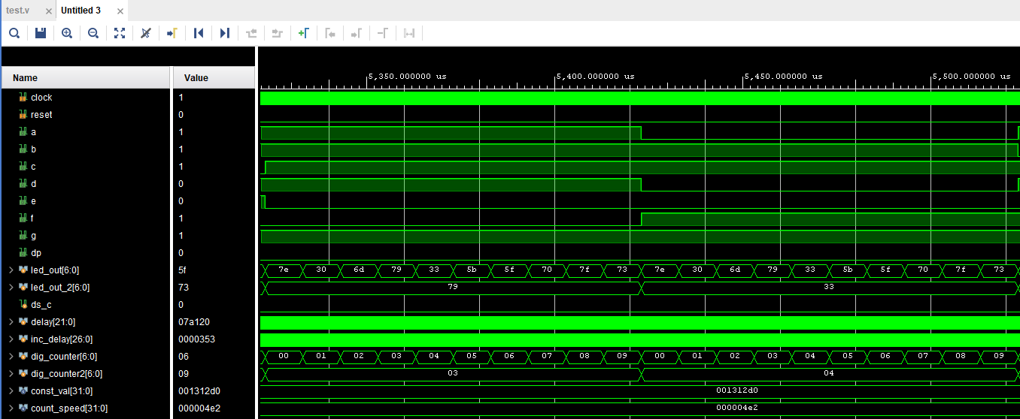
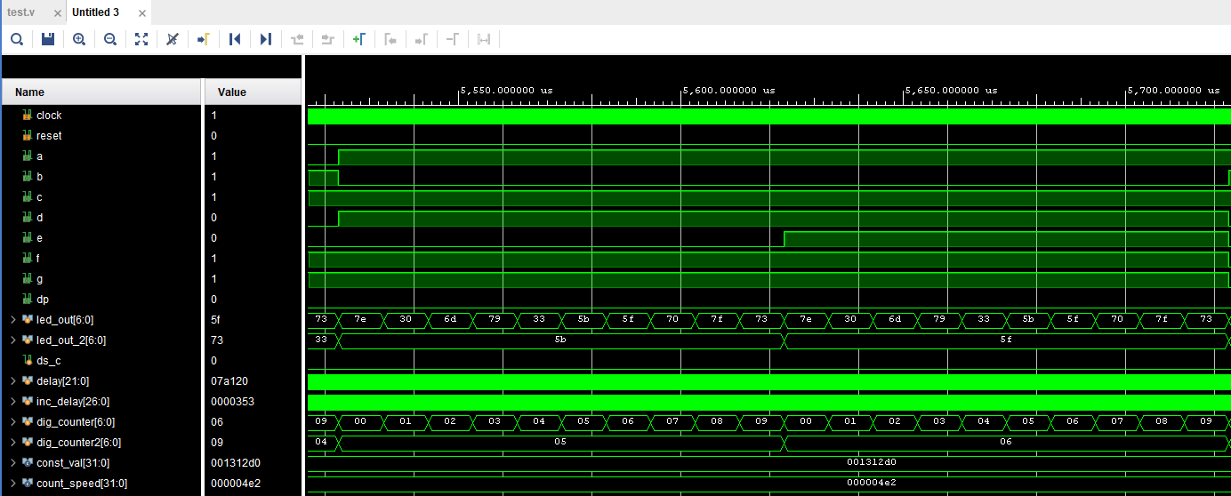

Slide 14
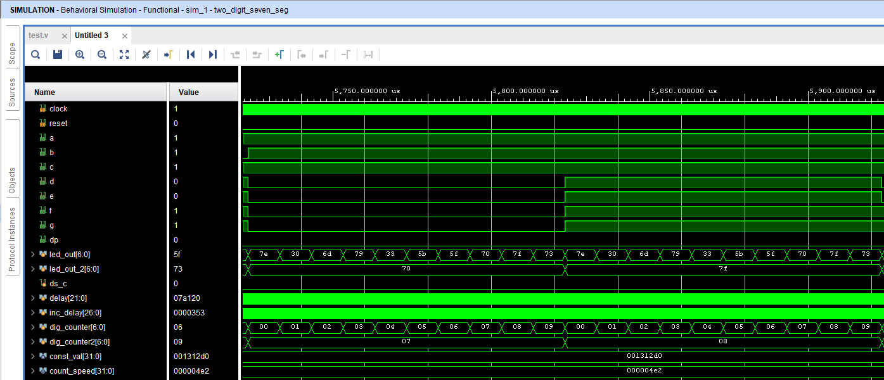
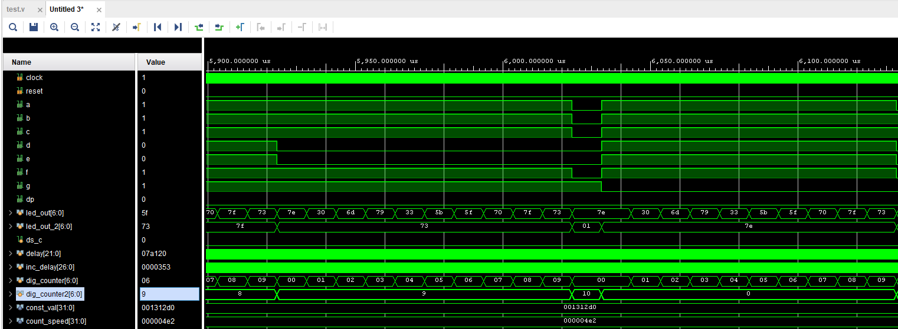

Slide 15
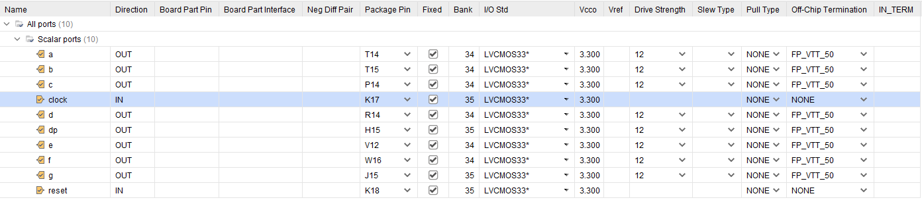
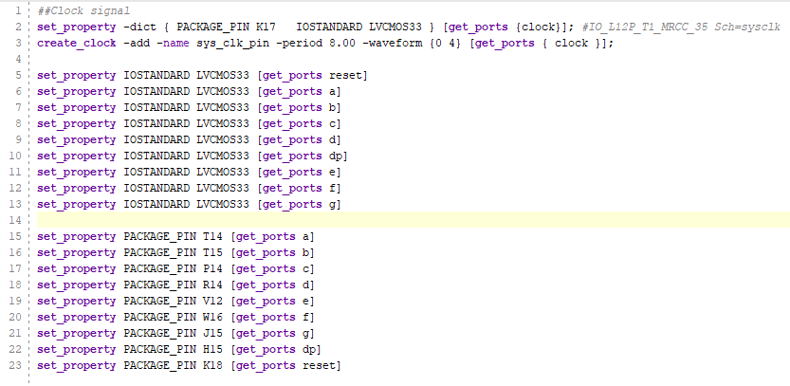
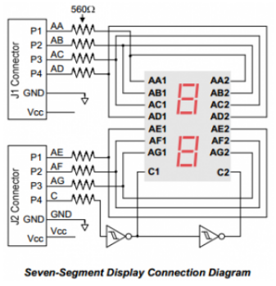
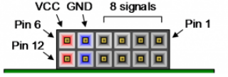
Constraints/XDC file
Zybo Pinouts for Pmods: JA -> JF
Notes:
Here are my constraints file that maps the pins to my board. These are found using the boards data sheet, as well as the pmods data sheet.

Slide 16
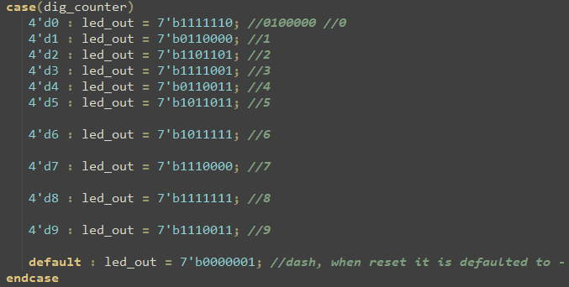
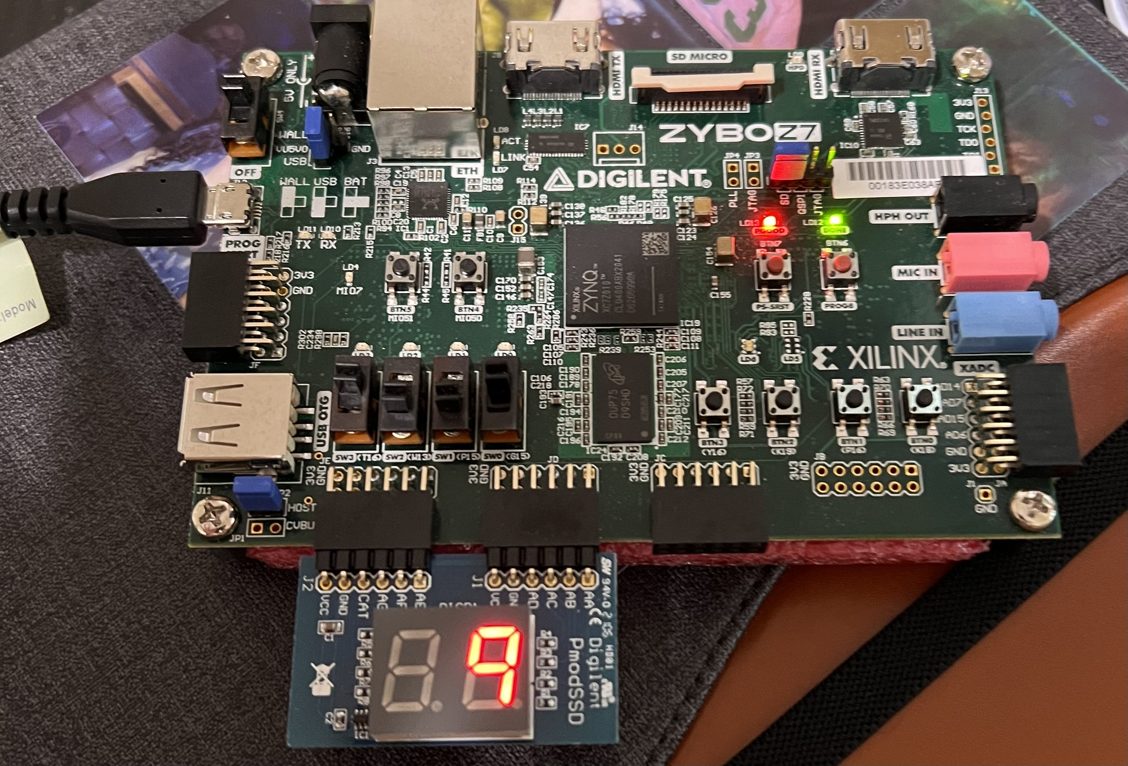
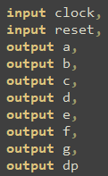
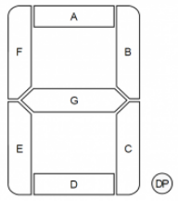
Results / Troubleshooting
Notes:
Here is a picture of my setup when I was testing the code. The image to the top right shows my testing of one of the digits counting. Unfortunately, my 2 digit seven segment display stopped functioning before I could run a full demo. It is incapable of showing any led at all. Other issues I had with this project was the coding process itself. I ran into issues where only one of the digits would appear at a time. This was due to me originally only having one counter called dig_counter. I fixed this issue by adding an additional counter known as dig_counter2 and using this as a separate counter for the other digit. Another issue was understanding how I would map the leds to the counter. I first used a direct plug and chug of 1’s and 0’s to light each led, but found that creating a case statement was more efficient. The concept of how the display functions, receiving input from a bitstream loaded onto the FPGA board is exactly how a UART functions. It is a simplex in terms of data communication since the FPGA board is the only transmitter/communicator of these two devices. Thank you. Any Questions.

Slide 17
Thank you
Questions?

